Slide 1

Dynamic Precision Medicine: A New Approach to Cancer Therapy Resistance
Robert A. Beckman, M.D.
Professor of Oncology, and of Biostatistics, Bioinformatics, & Biomathematics
Innovation Center for Biomedical Informatics and Lombardi Comprehensive Cancer Center
Georgetown University Medical Center
Scientific Advisor, Office of the Senior Vice President for Research
Georgetown University

Slide 2

A Different Perspective
Mathematical biology
5 decades of modeling various biological phenomena
Enzymatic mechanisms of DNA replication fidelity
Carcinogenesis
Treatment sequences in oncology
Optimizing oncology clinical trial designs
Cancer therapy development
23 therapies first in man
5 therapies advanced to late development
2 therapies approved:
Topotecan for small cell lung cancer
Bicalutamide for adjuvant therapy of prostate cancer
Small and large molecules targeting
Signal transduction
Repair
Angiogenesis
Developmental pathways
DNA vaccines, immunoliposomes, antibody-drug conjugates

Slide 3
Agenda
Genetic instability in cancer and implications for drug resistance
Dynamic precision medicine, a new approach to precision cancer therapy
simulation studies
laboratory studies
challenges and path to clinical translation
clinical study designs
Possible collaboration opportunities

Slide 4
Hypermutation: A Potential Mechanism of Resistance
Cancers have multiple genetically distinct subclones and they undergo continuous evolution
Some of these subclones have mutations in DNA replication or repair genes, genes required for chromosomal stability, or cell cycle checkpoints
These subclones are termed “hypermutator subclones” (Beckman and Loeb DNA Repair 2017)
Elimination of these subclones, even when rare, is seen to be crucial in simulations, as they can rapidly evolve resistance to several non-cross resistant agents (in the same cell) (Beckman et al PNAS 2012; Beckman and Loeb Clinical Pharmacology and Therapeutics 2020)

Slide 5
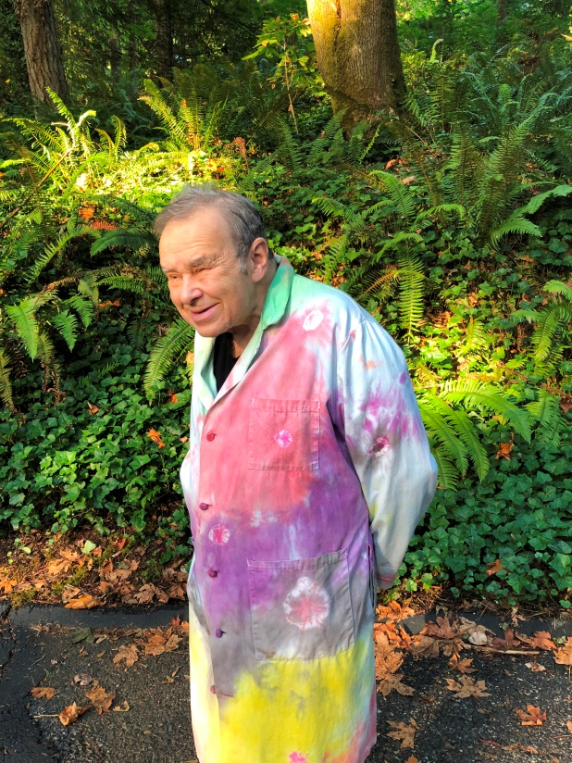
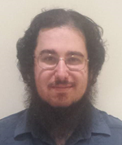
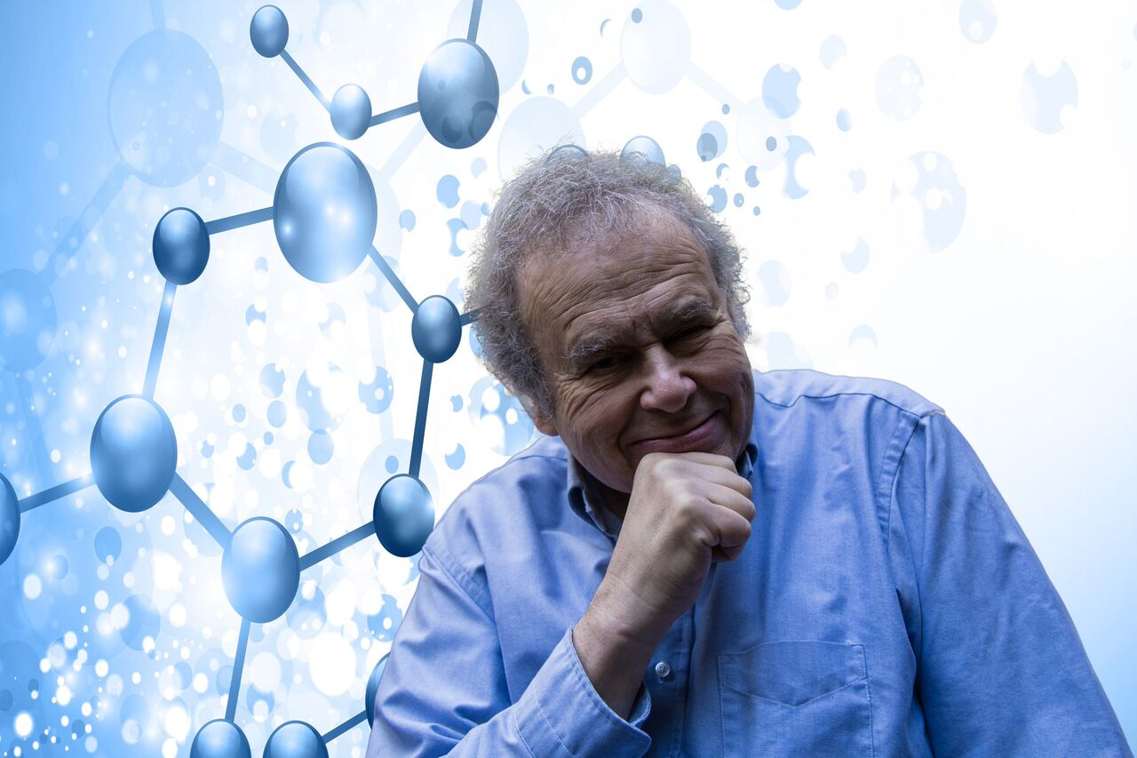
Unexpectedly High Subclonal Diversity in Human CRC
Collaborators: Larry Loeb and Brendan Kohrn

Slide 6
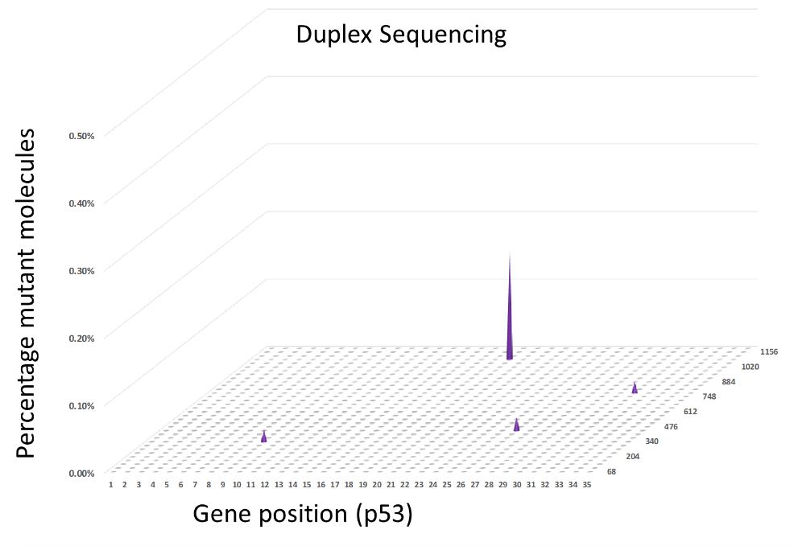
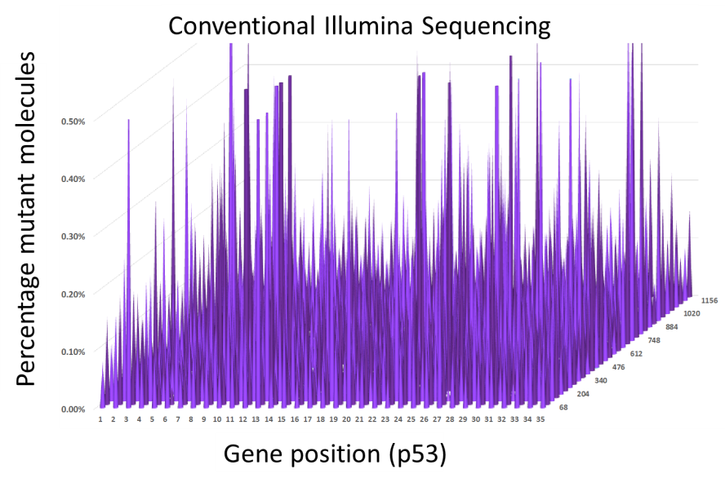
Duplex Sequencing Allows Sequencing at High Depth

Slide 7
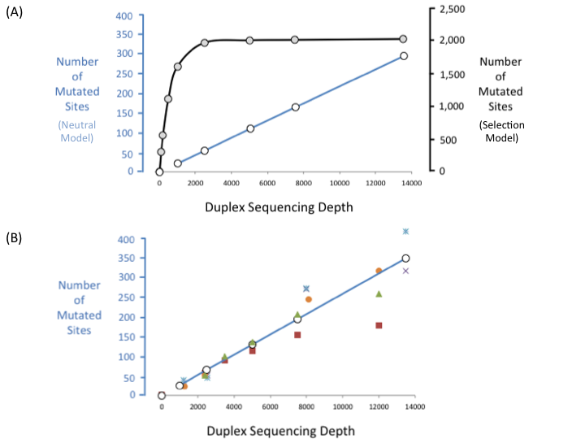
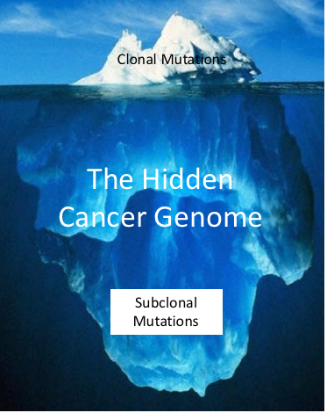
Clinical Evidence in Colorectal Cancer: Evolution Mechanisms and Mutational Diversity
Theoretical models with positive selection (black) and neutral evolution (blue)
Experimental data superposed on prediction of neutral evolution model
Subclonal diversity is much greater than previously believed
Resistance to any therapy is pre-existing in at least one cell at diagnosis
Multiply resistant cells arise with further tumor growth, faster than previously expected
Loeb et al PNAS 2019; Beckman and Loeb Clinical Pharmacology and Therapeutics 2020; Beckman npj Systems Biology and Applications 2024.

Slide 8
Detail: Implications of Diversity Findings
Subclonal diversity is much greater than previously believed: could not be detected by conventional sequencing
Resistance to any therapy is pre-existing in at least one cell at diagnosis
Any mutation at any site in the human genome will be present in at least one cell, unless that mutation reduced cellular fitness

Slide 9
Implications of Diversity Findings II:
The vast majority of clinically relevant resistant subclones are likely undetected unless sequencing done on bulk resistant tumor at relapse or autopsy

Slide 10
What is a Biologically Relevant Experiment?
Use observed subclones when 99.99% of diversity is undetected?

Slide 11
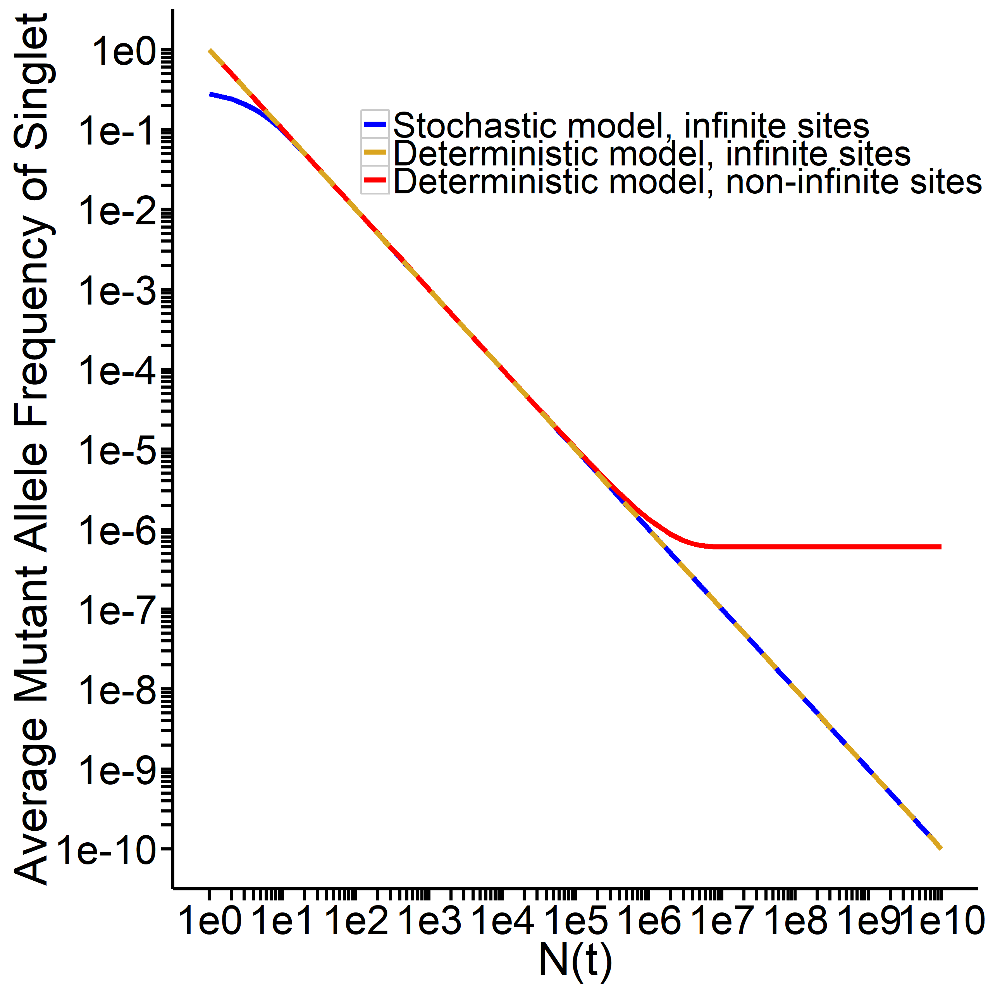
New Theory Predicts More Rapid Evolution Beyond a Critical Size (1 mm³)

Slide 12
Implications
Things get much worse as the tumor gets larger
Need to minimize diversity as early as possible

Slide 13

Dynamic Precision Medicine (DPM) (Beckman, Schemmann, and Yeang PNAS 2012)
Explicitly considers subclonal heterogeneity
Explicitly considers tumor evolution
Decisions based on probabilities and risk states
May consider factors that are not observable at that time
Frequent adaptations of therapy (“moves”) —as often as every six weeks
Long range planning
Prevention of moderate-long term relapse is the goal

Slide 14
Differences between Current Precision Medicine and Dynamic Precision Medicine
Current Precision Medicine:
Focus on average molecular characteristics
Focuses on current molecular characteristics and/or those at dx
Thinks primarily of current step
Treats with the same therapy until relapse or worsening: reactive
Mathematical optimization for signature development at current step
Dynamic Precision Medicine:
Minority subpopulations may be important
Considers endgame, especially “penultimate states”
Attempts to think several steps ahead
Adapts frequently and proactively
Piecewise, or even global, optimization across the treatment course

Slide 15
Dynamic Precision Medicine: 2 “drug” case
Two non cross resistant drugs or drug combos: Drug-1 and Drug-2 (i.e. RAF-MEK, PI3K)
Four cell types:
Sensitive cell S, killed by both Drug-1 and Drug-2
Resistant cell R1, killed only by Drug-2
Resistant cell R2, killed only by Drug-1
Incurable doubly resistant cell R1-2
Genetic and epigenetic transitions between cell types
Cell growth and death affected by drugs in dose dependent manner
Partial resistance
Patient can have a mixture of cells, which evolves over time
Combination therapy requires dose
reduction
R1
S
R1-2
R2

Slide 16
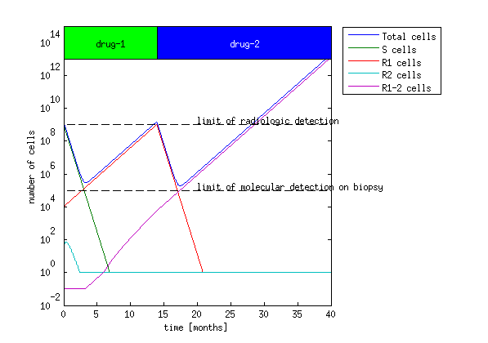
Current Precision Medicine: 28 months to incurable relapse

Slide 17
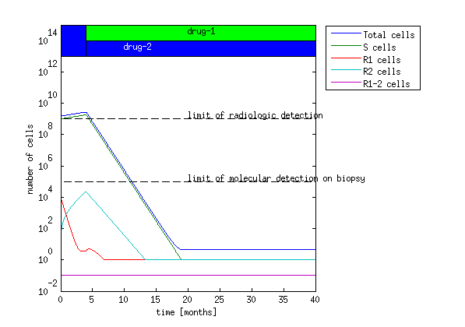
Dynamic Precision Medicine: Cure

Slide 18
Graphical Representation of Phenotypic States in Genetic Space

Slide 19
Key Features of Interest (Beckman, Kareva, and Adler Cancer Control 2020)
Designed for use with multiple non-cross resistant agents
Focus on preventing multiple resistance and late relapses
Subclones may evolve at different rates
Hypermutator subclones at high risk for multiple resistance

Slide 20
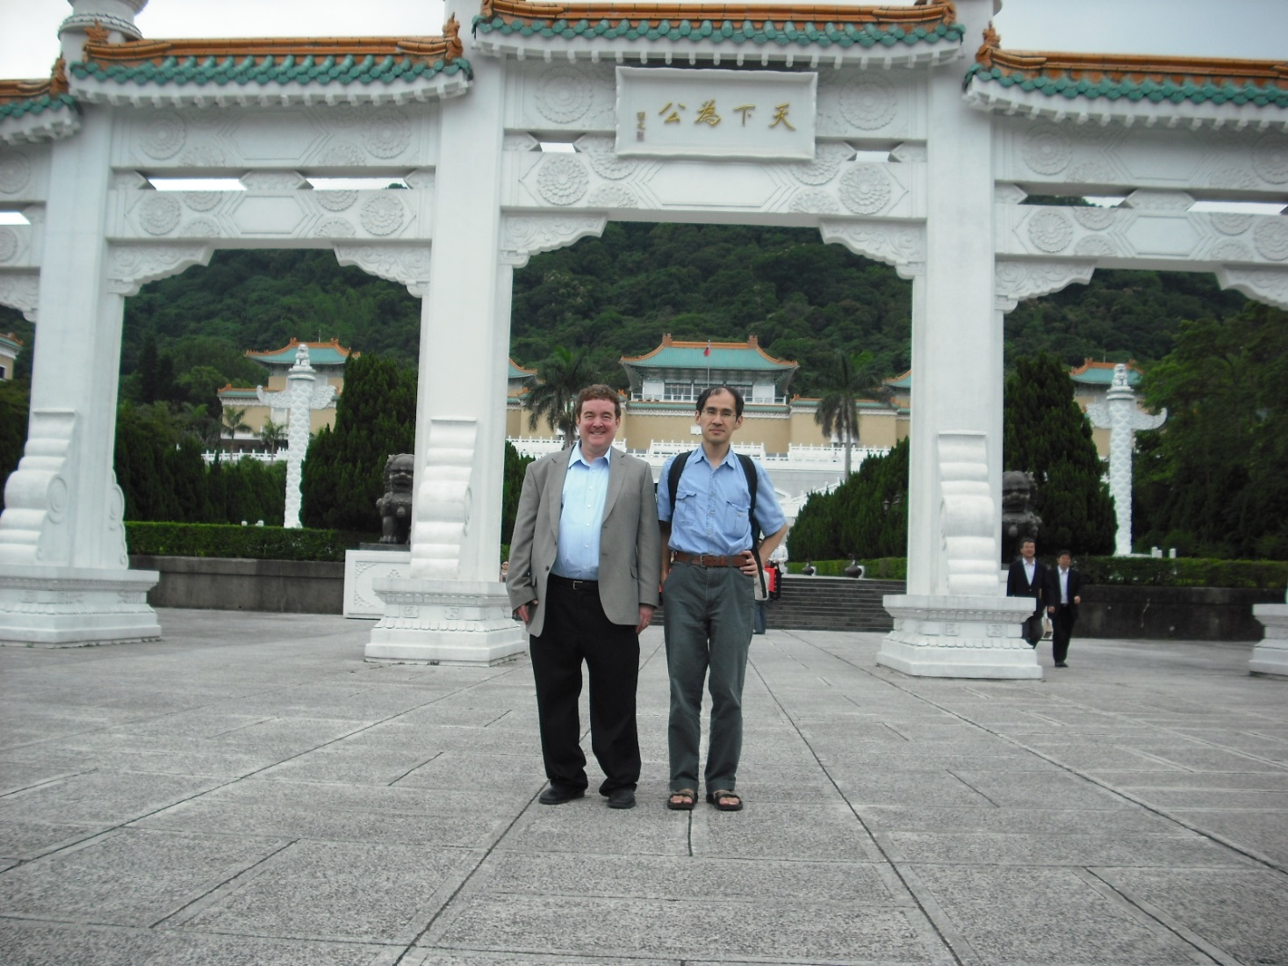
In Silico “Clinical Trial”: 3 million “patients”

Slide 21
Strategies
A strategy is a data-driven method for planning a sequence of therapies
When to treat with a combination and when to treat with sequential monotherapy
When to change therapies
An HPC simulation compared 6 strategies
Current precision medicine strategies: the patient is treated with the best drug for the observed predominant cell type and switched to the alternative drug upon tumor progression or relapse.
note: each “drug” may itself be a combination designed to kill a single subclone
DPM strategies:
Used the evolutionary model to predict the total cell number and the likelihood of forming an incurable cell at the next 45 day timepoint
Gave therapy that minimized either total cell number or incurable cell likelihood
Differed in method of prioritizing total cell number vs incurable cells

Slide 22
Examined 30 million parameter configurations encompassing:
Different initial populations
Different growth rates
Different transition rates
Different levels of sensitivity and resistance to drugs

Slide 23
Choosing the Parameter Ranges
Parameters varied over broad ranges to encompass all possibilities as found in the clinical and experimental literature
Transition rates varied over 8 orders of magnitude
Growth rates varied over 340 fold range
Possible parameter value combinations filtered by 2 criteria
Must correspond to a strategic choice: both drugs must provide at least minimal efficacy
Worst strategy must provide no more than 4 years survival time
Chose over 3 million parameter combinations; explored them all
Net result is sensitivity analysis across known tumor and therapy characteristics with strategic choices between 2 drugs and survival in the range of up to 4-5 years

Slide 24
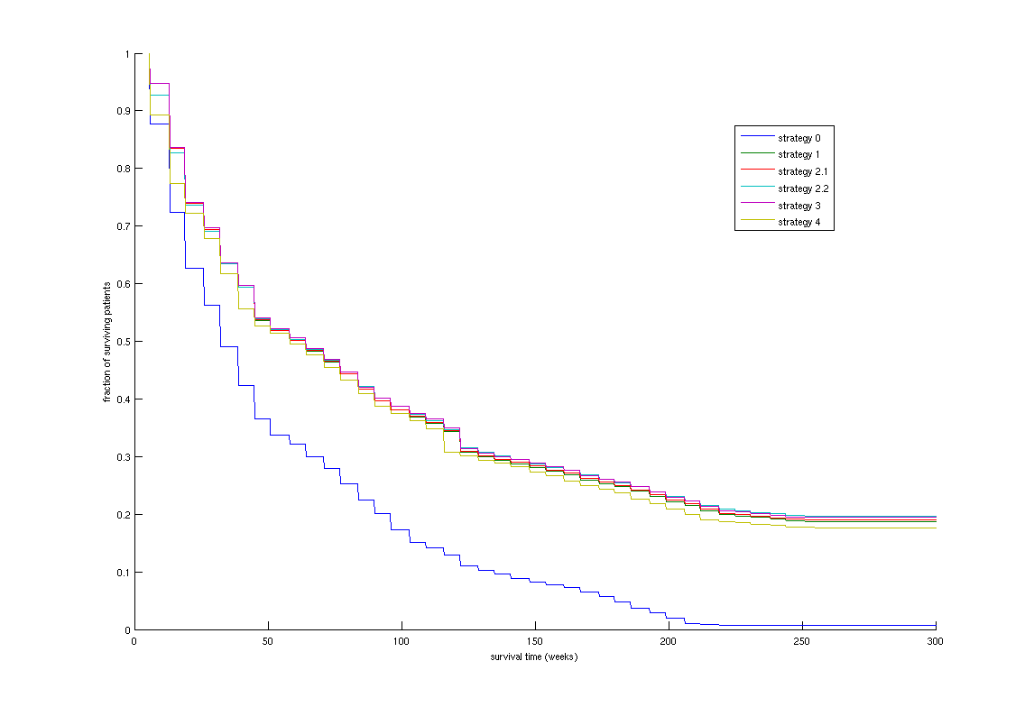
Benefit of dynamic precision medicine is very general

Slide 25
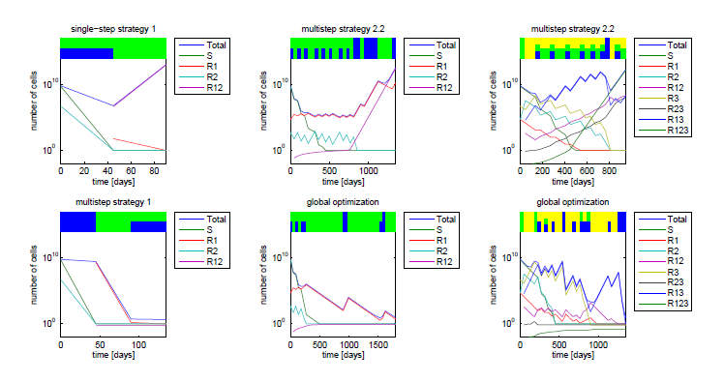
Tactical lessons
Rare cells matter
Hypermutator subclones are therapeutic priorities
Simultaneous combinations are important but not always the answer
Yeang and Beckman,
Biology Direct, 2016

Slide 26
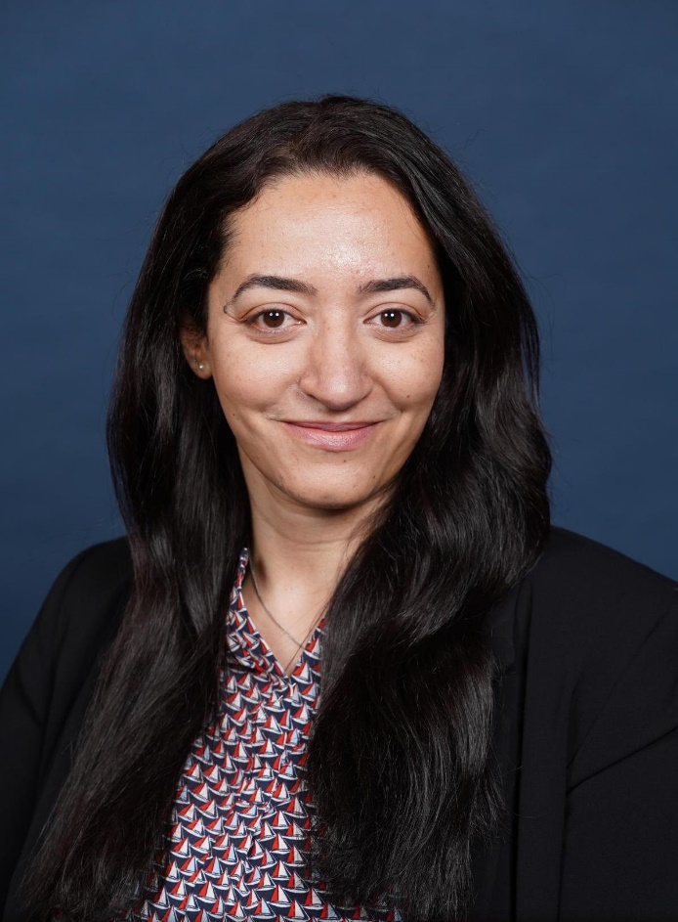
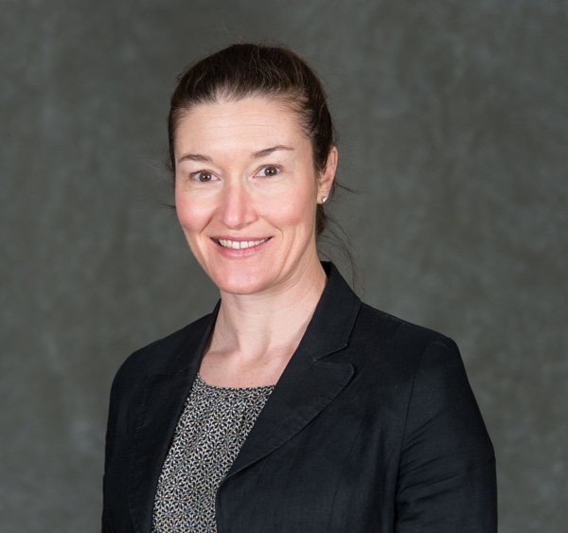
Ongoing Laboratory Studies
Shaymaa Bahnassy, Rebecca Riggins

Slide 27
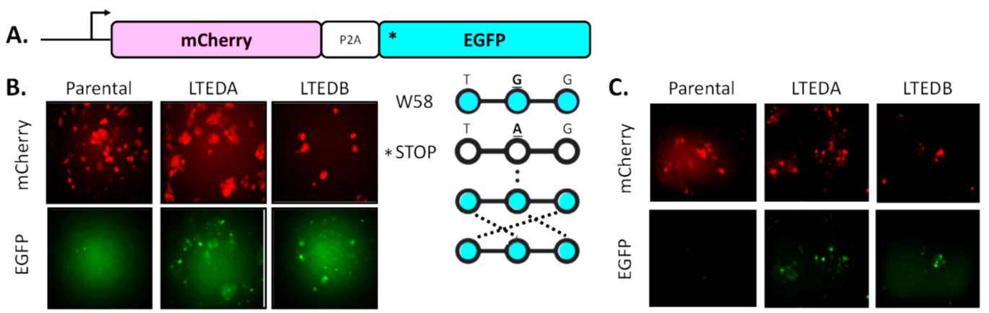
Hypermutators Selected in Evolution of Resistance (Riggins et al 2019)
Hypermutator subclones expected due to random mutations in genes responsible for genome integrity
Hypermutator subclones more likely to become resistant; enriched upon evolution of resistance
“Hypermutator” really refers to any type of genetic change
In this case, one resistant line had a higher mutation rate and the other a higher indel rate
Riggins, Podar

Slide 28
Testing Hypermutation in HER2+/ER+ Pre-Clinical Models – Duplex Sequencing
Polymerase capture panel
Predicted pathogenic mutations in POLD1 and POLE in MM361 LTED lines
Increased overall number, frequency of mutations in LTEDA
C>A, C>T (LTEDA), deletions (both)
Yasmin Dunn, Brendan Kohrn, Larry Loeb

Slide 29
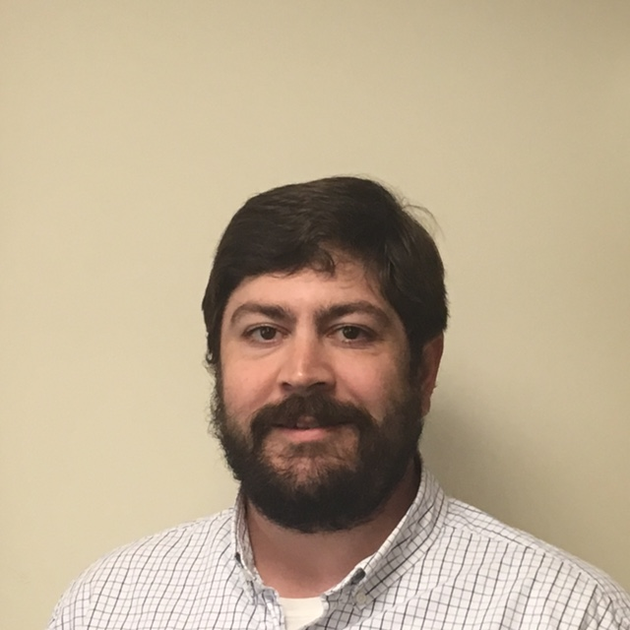

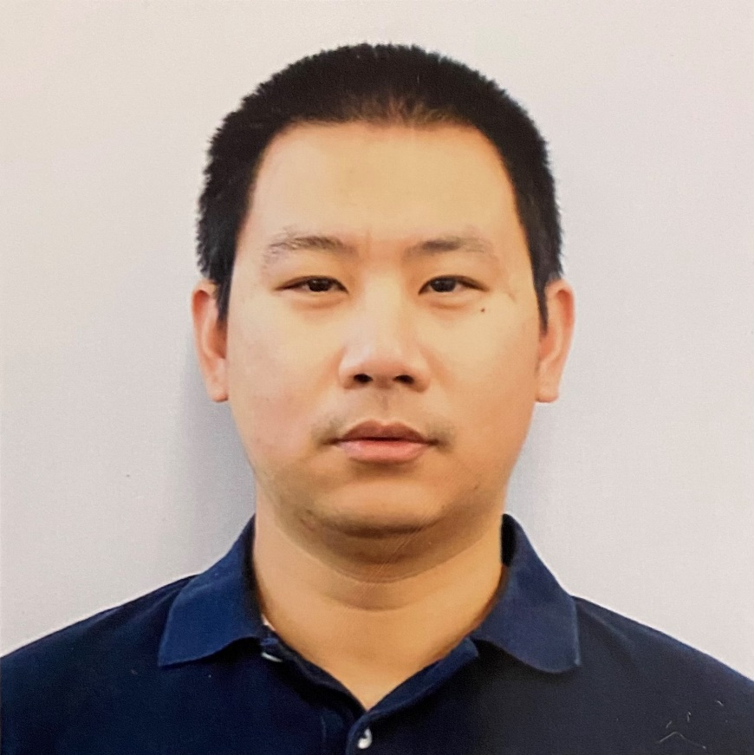
The Challenge of Clinical Translation
Collaborators: Matt McCoy, Deepak Parashar, Wei He

Slide 30
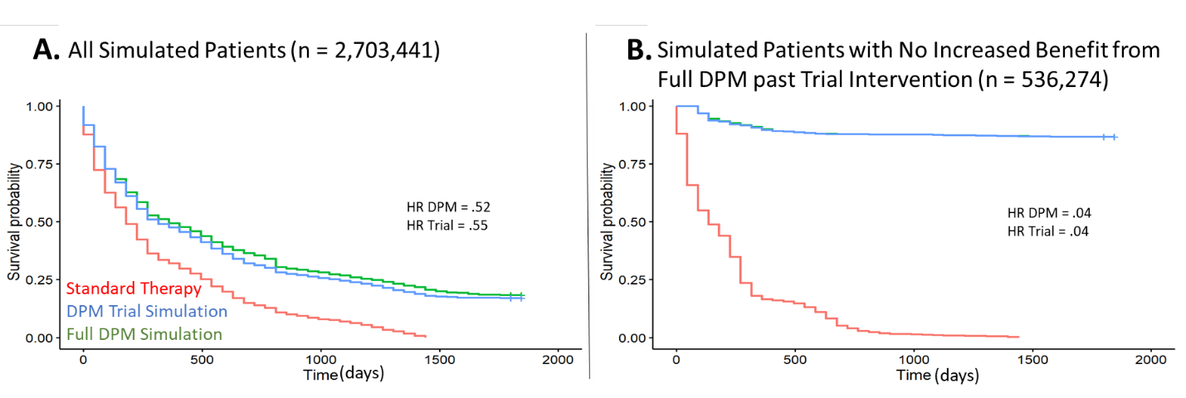
Early Moves Matter the Most (McCoy et al JCO PO in press 2025)
Comparison of DPM for 2 moves (trial DPM, blue) vs 40 moves (full DPM, green) vs standard PM (red)
If there is no difference between DPM recommendations and standard therapy recommendations in first two moves, the virtual patient will not benefit from DPM
Generalized evolutionary classifier for patient selection
McCoy et al,JCO
Precision Oncology, in press 2025

Slide 31
Neoadjuvant (Presurgical) Setting Is a Promising Application for DPM
Natural setting for a clinical “window study” of 2 moves
Availability of tissue
Cost, tissue requirements, and patient inconvenience dramatically reduced
High risk adjuvant (postsurgical) setting is also promising
Data from neoadjuvant setting used to personalize 3 month adjuvant window
This paradigm allows time for pharmacology experiments on neoadjuvant tissue

Slide 32
Data Requirements for DPM Adaptations
Ideally, at each time step, we would have the following input parameters:
High resolution data on prevalence of relevant subclones with differing sensitivity/resistance properties
Net growth rates of subclones in presence/absence of available therapies
Net mutation rates of relevant subclones
Reality:
Sensitivity limitations of sequencing, worse in liquid biopsies
Cannot have serial direct biopsies except in liquid tumors
Functional significance of mutations often unknown
Circulating tumor DNA does not discern whether there are cells simultaneously holding multiple mutations of interest

Slide 33
Mis-specification Simulations
How effective is DPM when input parameters assumed by the modeler are inaccurate due to insensitive, noisy, or missing data?
Mis-specification simulations assume the doctor is given the wrong information for one or more of the input parameters, and makes decisions based on this wrong information
The system evolves according to the ground truth
Impact of wrong sensitivity to drug 2: Deepak Parashar
Over or underestimating the sensitivity to drug 2 30-fold reduces, but does not eliminate clinical benefit: hazard ratio increases from 0.45 to 0.65
Impact of limited sensitivity of detection of rare subclones suggest values below LOD should be replaced with a theoretical pdf
Peter Mon, Wei He, Matt McCoy, Deepak Parashar

Slide 34
total
set by 0: ('strategy0', 'strategy2.2') set by pdf: ('strategy0', 'strategy2.2')
set by loguni: ('strategy0', 'strategy2.2') set by max: ('strategy0', 'strategy2.2')
0.725
0.700
0.675
0.650
0.625
0.600
0.575
0.550
0.525
Hazard ratio
10
9
10
6
10
5
10
4
10
3
10
2
10
1
LOD

Slide 35
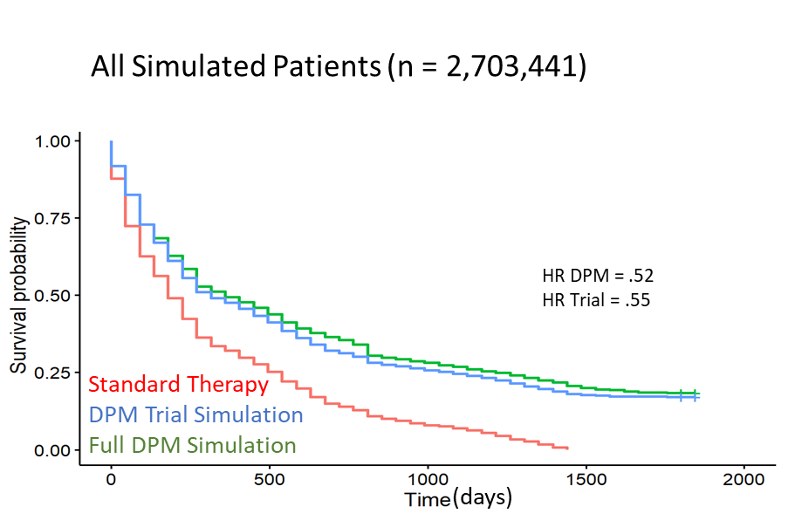


Searchable database of millions of virtual patients as digital twins for personalized real time decision support
Simulate CPDT Population
-User selected parameter range
and
-User selected set of treatment strategies
Clinical Interface
Analyze CPDT Population
-Compare outcomes on different strategies
-Identify parameter dependencies (where can increased parameter resolution aid decision making?)
Retrieve CPDT Population
Filter By:
-Parameter range
-Therapeutic strategy
-Outcome difference between 2 strategies
Survival time (Strategy 2)
CPDT
Database
Survival time (Strategy 1)
Notes:
And so how would that interface with the clinic. Here, I’m showing a schematic of the workflow, where the clinical decision maker brings their patient data, where it is mapped to model parameters. As an aside, this is another area where we need advances in technology, and is an active area of research on our team and others on this panel.
But independent of how that data is mapped to model parameters, or even independent of the specific digital twin model, the clinical interface will need to provide the decision maker with the ability to evaluate different interventions on that model.
In our case, we provide the option of evaluating different strategies for ordering two therapeutic options. For example, the standard therapy strategy would apply whatever drug is most effective on the majority of the tumor at each evaluation opportunity, while another strategy may make a therapeutic selection based on eliminating the emergence of multiply resistant subclones. That is, it may select a less effective drug for a short period of time based on detection of a rapidly growing, singly resistant subclone. We refer to this strategy as “dynamic” precision medicine, or DPM.
And since subsequent iterations developing a cancer digital twin are not modifying the underlying model, just the values and combinations of parameters, previously simulated twins can be retrieved to boost the patient defined population.
From there, the population can be analyzed. On the right I’m showing a couple different ways you can evaluate and compare the outcomes of different strategies on the set of digital twins.
The top figure is showing some results from comparing the two different strategies I previously mentioned. One where a choice between two drugs is made based on which drug works best on a majority of the cells, that one is in red, and another strategy where the drug choice is made to eliminate the emergence of a multiply resistant subclone, shown in green.
For this population of twins, the plot shows an increased survival with one method compared with the other and lends support for one therapeutic strategy compared to the other. We then evaluated a different strategy on the same population, shown in blue, where DPM was only applied for two steps before reverting to the standard therapy strategy. I wont get into the details here, but since DPM relies on data collected during regular biopsy, the blue line represents a much less invasive (and less expensive) strategy that would yield a comparable outcome to the full course of DPM.
And another way the results can be used is show in the figure below. Here, each axis of the plot shows the survival time of one of two therapeutic selections, and we color the individual twins based on clustering of the adjustable model parameters. We see that for some subsets of the population, strategy 1 is predicted to have better outcomes than strategy 2, like those in green. Or vise versa like those in yellow.
Based on the differences in the model parameters, there may be additional data collection that can help determine which population better describes that individual patient.
So overall, I would say that the project, and the pilot program in general to be quite beneficial to thinking about the practical application of digital twins in the clinic. We were able to think about how to work within the technical limitations in a generalized way, which is important because our technology and models will continue to improve.
Maybe now is the time to start thinking about how to standardize the way our twins interface with both the data collection and with the analysis of progression and outcomes.
And maybe even the population of twins is a population of different models with different assumptions and confidence.
So… thank you again. I look forward to your questions.

Slide 36
Collaboration possibilities with Turing Institute: parameter estimation and decision support
Use of public databases in defined populations to extract probability distributions for DPM parameters
Critical when data are not available for an individual patient
Partnership for searching of public data
Partnership for methods development to combine population input from public databases with incomplete individual patient data to allow personalized, probability weighted parameter estimation
Decision support tools:
Partnership for further refinement of decision tools described on digital twin slides
Development of user-friendly interfaces for health care providers

Slide 37
Clinical Trial Designs
Collaborator: Deepak Parashar

Slide 38
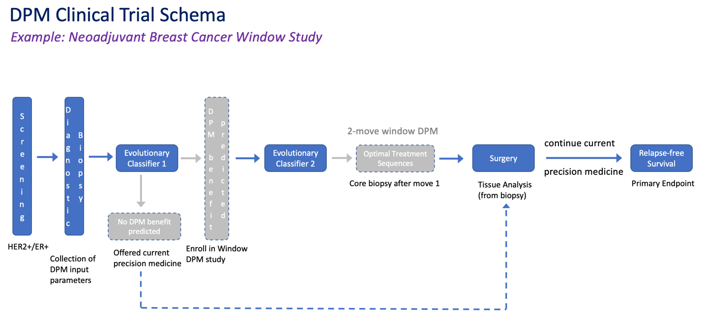
Pilot Clinical Study
21
22
McCoy et al JCO Precision Oncology 2025 in press

Slide 39
Proof-of-Concept Trial Design
Design 1: randomize between DPM and CPM strategies
Enroll full population
Stratify by evolutionary classifier
Within each stratum, randomize between DPM and current precision medicine (CPM)
Design 2: enrich for patients who are predicted to benefit by evolutionary classifier
Randomize these patients between DPM and CPM
Design 1 with 125 virtual patients per arm per stratum was used to simulate mis-specification of drug 2 sensitivity: manuscript in preparation

Slide 40
Confirmatory Trial Designs
These designs need to be confirmatory for the DPM strategy independent of any particular example
The hypothesis we are testing is: DPM can sort patients accurately into each individual optimal treatment sequence
Avoid confounding that some treatment sequences may perform better or worse than expected in all patients

Slide 41
Emerging confirmatory clinical trial design and simulation
Dr. Martyn Plummer from the Statistics Department of the University of Warwick will work with Drs. Parashar and Beckman
Simulation and optimization of hyperbasket design
Development of other alternative designs
These projects may benefit from AI/ML methods (Turing?)

Slide 42
Summary
DPM differs from both current precision medicine and other evolutionary guided paradigms and may lead to striking improvements in outcome across a broad range of therapies and clinical presentations.
DPM is designed for multiple therapies and aims to prevent late relapses.
Long range planning further enhances the benefits of DPM, yet DPM benefits can be seen after only several months, raising the possibility of a window study.
An evolutionary classifier identifies patients who will benefit most from DPM. The approach may be generalizable to other evolutionary guided approaches.
DPM is unique in identifying hypermutator subclones as a therapeutic priority.
Novel clinical trial designs to test DPM under development in collaboration with Dr. Parashar

Slide 43

Wayne Gretzky, Hockey Hall of Famer

Slide 44
References I
Akhmetzhanov, Andrei R., Kim, Jong-Wook, Sullivan, Ryan, Beckman, Robert A., Tamayo, Pablo and Chen-Hsiang Yeang. Modelling Bistable Tumour Population Dynamics to Design Effective Treatment Strategies. Journal of Theoretical Biology 474: 88-102 (2019).
Beckman RA, Kareva I, and Adler FR (2020). How should cancer models be constructed? Cancer Control 27: 1-12.
Beckman RA & Loeb LA (2020). Rare mutations in cancer drug resistance and implications for therapy. Clinical Pharmacology and Therapeutics, doi10.1002/cpt.1938.
Beckman RA, Schemmann GS, & Yeang CH (2012). Impact of genetic dynamics and single-cell heterogeneity on development of nonstandard personalized medicine strategies for cancer. Proceedings of the National Academy of Sciences of the United States of America 109(36):14586-14591.
Bozic I, et al. (2013). Evolutionary dynamics of cancer in response to targeted combination therapy. Elife 2:e00747
Bozic I, Gerold JM, & Nowak MA (2016). Quantifying clonal and subclonal passenger mutations in cancer evolution. PLoS computational biology 12(2):e1004731..
Goldie, JH & Coldman, AJ (1979). A mathematic model for relating the drug sensitivity of tumors to their spontaneous mutation rate. Cancer treatment reports 63, 1727-1733.
Kennedy SR, et al. (2014). Detecting ultralow-frequency mutations by Duplex Sequencing. Nature protocols 9(11):2586-2606.

Slide 45
References II
Kimura M (1969) The number of heterozygous nucleotide sites maintained in a finite population due to steady flux of
mutations. Genetics 61(4):893-903
Loeb LA, Kohrn BF, Loubet-Senear KJ, Dunn YJ, Ahn EH, O’Sullivan JN, Salk JJ, Bronner MP, & Beckman RA (2019). Extensive subclonal mutational heterogeneity in human colorectal cancer and its significance Proceedings of the National Academy of Sciences of the United States of America 116: 26863-26872.
Madhavan S, Beckman RA. McCoy MD, Pishvaian MJ, Brody JR, & Macklin, Paul (2021). Envisioning the future of precision oncology trials. Nature Cancer, 2: 9-11.
McCoy MD, Yeang CH, Tam S, Bahnassy S, Riggins RB, Parashar D, & Beckman RA (2025). A generalized evolutionary classifier (EC) for evolutionary guided precision medicine (EGPM) JCO Precision Oncology, in press.
Reiter JG et al (2019). An analysis of genetic heterogeneity in untreated cancers. Nature Reviews Cancer 19 639-650.
Riggins RB, Stires H, Balachandran M, et al. (2019). Estrogen receptor heterogeneity and signaling in HER2+/ER+ breast cancer. Hormone-Dependent Cancers Gordon Research Conference, Newry, ME.
Schmitt MW, et al. (2012) Detection of ultra-rare mutations by next-generation sequencing. Proceedings of the National Academy of Sciences of the United States of America 109(36):14508-14513.
Williams MJ, Werner B, Barnes CP, Graham TA, & Sottoriva A (2016) Identification of neutral tumor evolution across cancer types. Nature genetics 48(3):238-244.
Yeang CH & Beckman RA (2016) Long range personalized cancer treatment strategies incorporating evolutionary dynamics. Biol Direct 11(1): 1-25.

Slide 46



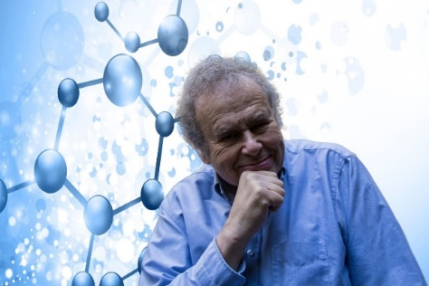
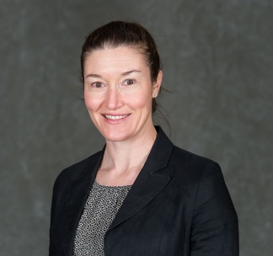

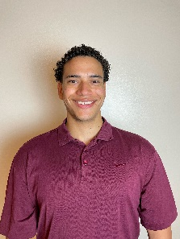
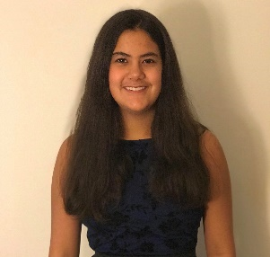
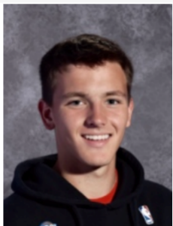


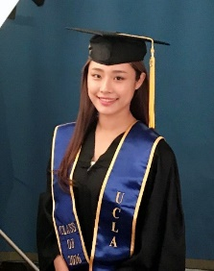

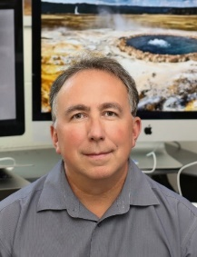
Acknowledgements Deepak Parashar(U Warwick), Andrei Akhmetzhanov (National Taiwan University), Larry Loeb, Brendan Kohrn, Larry Loeb again(!) (University of Washington), Rebecca Riggins (GUMC), Wei He (GUMC), Cutler Simpson (GUMC), Richa Kuklani (GUMC), Peter Mon (Byram Hills High School), Shaymaa Bahnassy (GUMC), Matt McCoy (GUMC), Vanessa Yang (GUMC), Chen-Hsiang Yeang (Academia Sinica), Mircea Podar (Oak Ridge National Laboratory)

Slide 47
Acknowledgements
Dynamic precision medicine:
Chen-Hsiang Yeang, Gunter Schemmann
Andrei Akhmetzhanov, Pamela Becker, Shaymaa Bahnassy, Nora Carbine, Robert Clarke, Yasmin Dunn, Wei He, Kylan Kelley, Brendan Kohrn, Richa Kuklani, Lawrence Loeb, Frank McCormick, Matthew McCoy, Peter Mon, Ben Park, David Parkinson, Deepak Parashar, Mircea Podar, Paula Pohlmann, Igor Puzanov, Rebecca Riggins, Cutler Simpson, Ryan Sullivan, Vanessa Yang
Dynamic precision medicine work initiated while CHY and RAB were members (CHY,RAB) and visitors (RAB) at the Simons Center for Systems Biology, Institute for Advanced Study (IAS), Princeton, NJ
Collaboration with Deepak Parashar (University of Warwick, UK) funded in part by the British Royal Society International Exchanges Award
Collaboration with Mircea Podar funded by Oak Ridge National Laboratory
RAB and Rebecca Riggins funded in part by Department of Defense Breast Cancer Research Program Breakthrough Award

Slide 48
Backups

Slide 49
The Central Equation of the Model
is a vector of cell number
is a normalized drug dosage vector
I is the identity matrix, T is the transition rate matrix between cell types by heritable changes
diag is an operator which places the components of a vector on the matrix diagonal
S_{a} is the sensitivity matrix of each cell type to each drug in increasing the death rate
U is the Heaviside operator, which is zero when its argument is < 0; otherwise 1.

Slide 50
Ongoing Laboratory Studies, Riggins Lab, Hypothesis: Hypermutator cells in HER2+/ER+ Breast Cancer Drive Resistance to Therapy
Aim 1A: Establish the full dynamic range of the fluorescent hypermutation detection assay.
Wild type and R689W hypermutator POLD1 alleles → MM361 and BT474 parental cells
Bulk → FACS-sorted GFP+, and GFP- → 10X Genomics scRNAseq and Duplex Seq
Aim 1B: Directly test how hypermutation impairs response to HER2- and ER-targeted therapy.
Trastuzumab+pertuzumab, tucatinib, fulvestrant
Bulk → FACS-sorted GFP+, and GFP-
MM361 and BT474 parental and LTED
MM361 and BT474 parental transduced with POLD1 from Aim 1A

Slide 51
Ongoing Laboratory Studies, Riggins Lab, Hypothesis: Hypermutator cells in HER2+/ER+ Breast Cancer Drive Resistance to Therapy
Aim 1C: Develop a model for DPM in HER2+/ER+ breast cancer
Use growth, death, and mutation rates for sensitive and resistant GFP+ and GFP- subclones; and sensitivity to drugs measured in Riggins lab as inputs
.Use dynamic precision medicine algorithm to predict complex optimal therapy sequences for selected mixtures
Test and iteratively refine predictions against experiment

Slide 52
Ongoing Laboratory Studies, Riggins Lab, Hypothesis: Hypermutator cells in HER2+/ER+ Breast Cancer Drive Resistance to Therapy
Aim 2: Quantify the emergence of hypermutators in HER2+/ER+ models in vivo
MM361 and BT474 parental and LTED, CTG-1478 HER2+/ER+ PDX model
Lentiviral system → scRNAseq
in 1º tumors, mets, CTCs
Phil Miller

